Slide 1

Special Cause Variation
“There is no substitute for knowledge.” (W. Edwards Deming)
Quality Support Group Webinar
Jim Leonard, Sr. Consultant

Slide 2
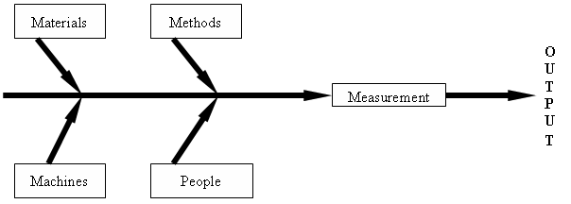
Shewhart’s Concept of a Process
Notes:
2

Slide 3
I.D.
SPEC: 1.0” +/- 0.1”
“EXCESSIVE” VARIATION
ALLOWABLE VARIATION
“EXCESSIVE” VARIATION
0.9” 1.1”
0.9 1.1
“BAD”
“GOOD”
“BAD”
Copyright 1987-2020 James F. Leonard.

Slide 4
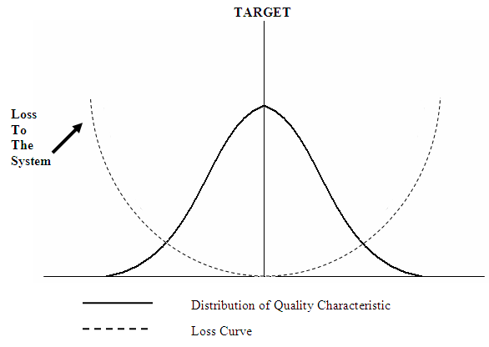
Systems Model of Variation
LSL
T
USL
Notes:
4

Slide 5
Systems Model of Variation
x
LSL
T
USL
Copyright 1987-2020 James F. Leonard.
Notes:
5

Slide 6
Systems Model of Variation
x
LSL
T
USL
Copyright 1987-2020 James F. Leonard.
Notes:
6

Slide 7
WHAT IS QUALITY?

Slide 8
NEW DEFINITIONS
Quality Minimal variation around some
target or optimum value
Quality Reduced variation over time
Improvement around some target or optimum
value
Copyright 1987-2020 James F. Leonard.

Slide 9
QUESTIONS TO ADDRESS
VIA SYSTEMS THINKING
1. Who are our customers?
2. What are their needs?
3. How can we best meet those needs...
  Showing minimal variation?
  And continuous improvement?
4. How are we doing?
5. What can we do better?
Copyright 1987-2020 James F. Leonard.

Slide 10
Shewhart’s Concept of a Process
Notes:
10

Slide 11
Process Model from the “Age of Mythology”
PERSON OUTPUT
Copyright 1987-2020 James F. Leonard.

Slide 12
Shewhart’s Concept of a Process
Notes:
12

Slide 13
Essential Statistical Methods
Basic Statistical Methods
Intermediate Statistical Methods
Advanced Statistical Methods
Copyright 1987-2020 James F. Leonard.
Notes:
13

Slide 14
Systematic Root Cause Analysis
1. Name the problem (Problem Statement)
    Include both an object and an action
    Be specific, and deal with only one problem
    Make sure it names a problem for which the cause is unknown
2. Describe the problem (Problem Specification)
    Dimensions IS IS NOT Distinctions Changes
    WHAT
    WHERE
    WHEN
    SIZE
3. List possible causes
4. Test possible causes
  Against the facts noted in the Problem Specification
5. Identify the “most likely” cause
6. Verify the true cause
  Pose and seek answers to good open questions
Copyright 1987-2020 James F. Leonard.

Slide 15
“Why was it, he wondered, that the level of defective tubes had stayed relatively stable, around 4-1/2 to 5-1/2 percent for two years? My answer: The engineers were confusing common causes with special causes. Every fault was to them a special cause, to track down, discover, and eliminate. They were trying to find the causes of ups and downs in a stable system, making things worse, defeating their purpose.”
W. Edwards Deming, The new Economics for Industry, Government, Education, MIT Center for Advanced Engineering Study, Cambridge, MA (1993)

Slide 16
Types of Variation (Shewhart)
1. “Controlled” Variation
    Random
    Mathematically Predictable
    Due to Random Chance
2. “Uncontrolled” Variation
    Non-random
    Not Mathematically Predictable
    Due to “Assignable Cause”
Copyright 1987-2020 James F. Leonard.

Slide 17
Types of Variation (Shewhart and Deming)
1. “Controlled” Variation “Common
    Random Cause”
    Mathematically Predictable
    Due to Random Chance
    Due to common causes of variation
    From within the process or system
Copyright 1987-2020 James F. Leonard.

Slide 18
Shewhart’s Concept of a Process
Notes:
18

Slide 19
Types of Variation (Shewhart and Deming)
1. “Controlled” Variation “Common
    Random Cause”
    Mathematically Predictable
    Due to Random Chance
    Due to common causes of variation
    From within the process or system
2. “Uncontrolled” Variation “Special
    Non-random Cause”
    Not Mathematically Predictable
    Due to “Assignable Cause”
    Due to some special cause of variation
    From outside the process or system
Copyright 1987-2020 James F. Leonard.

Slide 20
Shewhart’s Concept of a Process
Notes:
20

Slide 21
Systematic Root Cause Analysis
1. Name the problem (Problem Statement)
    Include both an object and an action
    Be specific, and deal with only one problem
    Make sure it names a problem for which the cause is unknown
2. Describe the problem (Problem Specification)
    Dimensions IS IS NOT Distinctions Changes
    WHAT
    WHERE
    WHEN
    SIZE
3. List possible causes
4. Test possible causes
  Against the facts noted in the Problem Specification
5. Identify the “most likely” cause
6. Verify the true cause
  Pose and seek answers to good open questions
Copyright 1987-2020 James F. Leonard.

Slide 22
Types of Variation (Shewhart and Deming)
1. “Controlled” Variation “Common
    Random Cause”
    Mathematically Predictable
    Due to Random Chance
    Due to common causes of variation
    From within the process or system
2. “Uncontrolled” Variation “Special
    Non-random Cause”
    Not Mathematically Predictable
    Due to “Assignable Cause”
    Due to some special cause of variation
    From outside the process or system
Copyright 1987-2020 James F. Leonard.

Slide 23
Shewhart’s Concept of a Process
Notes:
23

Slide 24
Deming’s Mistake 1 (“Tampering”)
30 - 25 - 20 - 15 - 10 - 5 0 + 5 + 10 + 15 + 20 + 25 + 30
SET POINT
Copyright 1987-2020 James F. Leonard.

Slide 25
Deming’s Mistake 1 (“Tampering”)
30 - 25 - 20 - 15 - 10 - 5 0 + 5 + 10 + 15 + 20 + 25 + 30
SET POINT
Copyright 1987-2020 James F. Leonard.

Slide 26
Deming’s Mistake 1 (“Tampering”)
X
30 - 25 - 20 - 15 - 10 - 5 0 + 5 + 10 + 15 + 20 + 25 + 30
SET POINT
Copyright 1987-2020 James F. Leonard.

Slide 27
Deming’s Mistake 1 (“Tampering”)
X
30 - 25 - 20 - 15 - 10 - 5 0 + 5 + 10 + 15 + 20 + 25 + 30
SET POINT
Copyright 1987-2020 James F. Leonard.

Slide 28
Deming’s Mistake 1 (“Tampering”)
X
30 - 25 - 20 - 15 - 10 - 5 0 + 5 + 10 + 15 + 20 + 25 + 30
SET POINT
Copyright 1987-2020 James F. Leonard.

Slide 29
Deming’s Mistake 1 (“Tampering”)
X
30 - 25 - 20 - 15 - 10 - 5 0 + 5 + 10 + 15 + 20 + 25 + 30
SET POINT
Copyright 1987-2020 James F. Leonard.

Slide 30
Deming’s Mistake 1 (“Tampering”)
30 - 25 - 20 - 15 - 10 - 5 0 + 5 + 10 + 15 + 20 + 25 + 30
SET POINT
Copyright 1987-2020 James F. Leonard.

Slide 31
Systems Model of Variation
LSL
T
USL
Notes:
31

Slide 32
Types of Variation (Shewhart and Deming)
1. “Controlled” Variation “Common
    Random Cause”
    Mathematically Predictable
    Due to Random Chance
    Due to common causes of variation
    From within the process or system
2. “Uncontrolled” Variation “Special
    Non-random Cause”
    Not Mathematically Predictable
    Due to “Assignable Cause”
    Due to some special cause of variation
    From outside the process or system
Copyright 1987-2020 James F. Leonard.

Slide 33
Tampering Teams
“We trained hard, but it seemed that every time
we were beginning to form up into teams, we
would be reorganized. I was to learn later in
life that we tend to meet any new situation by
reorganizing; and a wonderful new method it
can be for creating the illusion of progress
while producing confusion, inefficiency, and
demoralization.”
> Centurion Gaius Petronius, 66 A.D.

Slide 34
Types of Variation (Shewhart and Deming)
1. “Controlled” Variation “Common
    Random Cause”
    Mathematically Predictable
    Due to Random Chance
    Due to common causes of variation
    From within the process or system
2. “Uncontrolled” Variation “Special
    Non-random Cause”
    Not Mathematically Predictable
    Due to “Assignable Cause”
    Due to some special cause of variation
    From outside the process or system
?---------------------------------------------------?
Copyright 1987-2020 James F. Leonard.

Slide 35
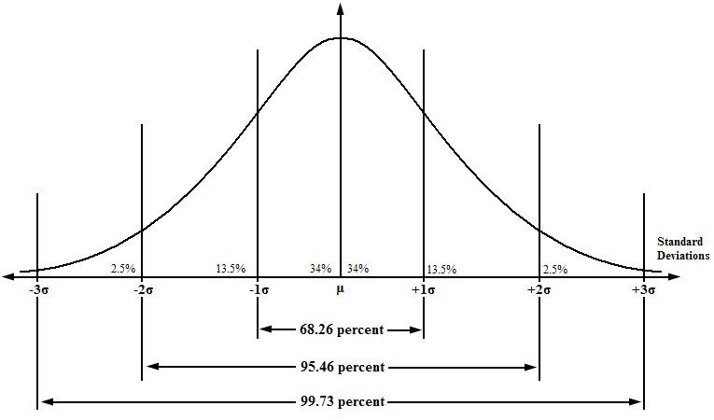
“Normal” Distribution Curve
σ’
X-bar

Slide 36
“Normal” Distribution Curve
Copyright 1987-2020 James F. Leonard.

Slide 37
“Normal” Distribution Curve
Copyright 1987-2020 James F. Leonard.

Slide 38
“Normal” Distribution Curve
Copyright 1987-2020 James F. Leonard.

Slide 39
“Normal” Distribution Curve
.00135
Copyright 1987-2020 James F. Leonard.

Slide 40
“Normal” Distribution Curve
- - - - - - - - - - - - - - - COMMON - - - - - - - - - - - - - - - CAUSES
SPECIAL
CAUSE
SPECIAL
CAUSE
100
Copyright 1987-2020 James F. Leonard.

Slide 41
“Normal” Distribution Curve
COMMON
CAUSES
SPECIAL
CAUSE
SPECIAL
CAUSE
2 DICE ROLLS 12
100
Copyright 1987-2020 James F. Leonard.

Slide 42
“Normal” Distribution Curve
COMMON
CAUSES
SPECIAL
CAUSE
SPECIAL
CAUSE
2 DICE ROLLS 12
13!!!
100
Copyright 1987-2020 James F. Leonard.

Slide 43
“Normal” Distribution Curve

Slide 44
SPECIAL
UCL
C
O
M
M
O
N
CL
LCL
TIME----------------------------------…
Copyright 1987-2020 James F. Leonard.

Slide 45
UCL
C
O
M
M
O
N
CL
LCL
TIME----------------------------------…
Copyright 1987-2020 James F. Leonard.

Slide 46
Deming’s Mistake 1 (“Tampering”)
X
X
30 - 25 - 20 - 15 - 10 - 5 0 + 5 + 10 + 15 + 20 + 25 + 30
SET POINT
Copyright 1987-2020 James F. Leonard.

Slide 47
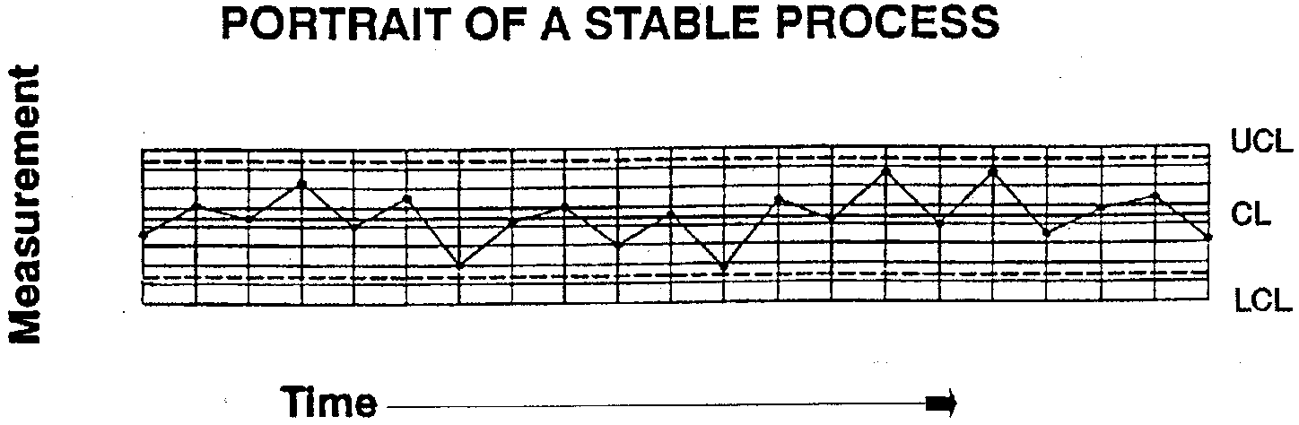
Stable Process
In statistical control
Variation is the result of common causes only (from within the system)
No special cause variation (from outside the system)
Copyright 1987-2020 James F. Leonard.

Slide 48
Shewhart’s Concept of a Process
Notes:
48

Slide 49
Process Capability
Definition: The random, inherent, common cause variation
we observe in a process.
Portrait of A Process’s Capability:
Measurements
Copyright 1987-2020 James F. Leonard.

Slide 50
Capable Process
In statistical control
100% of the output ( X-bar ± 3σ’ ) all meets quality requirements
Lower
Spec
Limit
Upper
Spec
Limit
Measurements of Process Output
Copyright 1987-2020 James F. Leonard.

Slide 51
Process Capability Index (Cpk) Calculation
COMPUTE FOR STABLE
PROCESSES ONLY
X-bar
- 3σ’
+ 3σ’
LSL
USL
------------------A-----------------
Cpk = A / B
-----------B------------
Cpk target minimum = 1.33
Copyright 1987-2020 James F. Leonard.

Slide 52
Advantages of Statistical Control
Its performance is predictable; quality characteristics remain constant.
Costs are predictable.
Productivity is at a maximum for the process.

Slide 53
Shewhart’s Concept of a Process
Notes:
53

Slide 54
Advantages of Statistical Control
Its performance is predictable; quality characteristics remain constant.
Costs are predictable.
Productivity is at a maximum for the process.
Effects of change are measurable.
A stable process provides sound arguments for altering specifications that can’t be met economically.
A process can be improved if, and only if, it is stable.

Slide 55
“It is a hazard to use judgment to distinguish between special causes and common causes…
“The naked eye looking at figures is not a safe guide…”
“[The Shewhart control charts] serve the purpose well…”
W. Edwards Deming, Out of the Crisis, p. 320.

Slide 56
Tests for Non-Random, Special Cause Variation
One point outside control limits
Run of significant length
Number of runs
Trends
Copyright 1987-2020 James F. Leonard.

Slide 57
Certificate of Conformance Results for Incoming Batches
USL
LSL
TIME
Copyright 2020 James F. Leonard.

Slide 58
Certificate of Conformance Results for Incoming Batches
USL
LSL
TIME
Copyright 2020 James F. Leonard.

Slide 59
In closing…
Special Cause variation is uncontrolled, non-random and not mathematically predictable. It is due to some special cause (Walter Shewhart called it “assignable cause”) of variation from outside the process or system. Special causes produce outcomes that are not different, they’re significantly different.
No amount of work on the process will correct special cause variation. The appropriate corrective strategy is to find, remove, and prevent the reoccurrence of the special cause. Systematic root cause analysis is extremely effective in this regard – but only when applied with guidance of knowledge.
Copyright 1987-2020 James F. Leonard.

Slide 60
“There is no substitute for knowledge.” (W. Edwards Deming)

Slide 61
Thank you for taking the time to sit in on our Webinar.
Questions?
Comments?
Curses?
Jim Leonard, Sr. Consultant
Quality Support Group
jim.leonard@qualitysupportgroup.com

Slide 62


Slide 63
“In times of change, the learners will
inherit the earth, while the learned
will find themselves beautifully
equipped to deal with a world that
no longer exists.”
> Eric Hoffer

